Slide 1


Battleship
Advanced Java Programming
Instructor: Dr. Kobra Amirizirtol
Ryan Goodrich, Marcelo Zapatta, Braden Messbarger

Slide 2
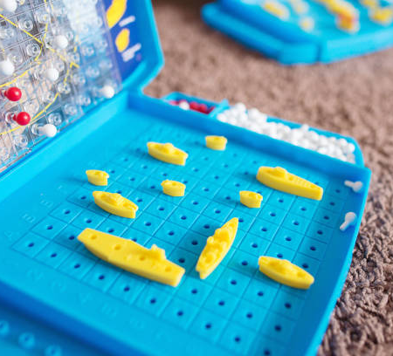
General Rules
Players each have two boards - which we call the “Ocean” and the “Radar”.
The “Ocean” contains 5 unique ships that are placed on a 10x10 labeled grid
The “Radar” is filled throughout the game after a player’s turn is taken.
Players’ “Ocean” boards are never visible to the opponent
Players take turns by guessing a location on the opponents board where a ship may be located.
If the location is correct, the player marks on their radar the corresponding location in red: a registered “HIT”
If the location does not have a ship, the radar is marked white: a registered “MISS”
If all locations of a specific ship are hit, the ship is said to be “SUNK”
Players win the game by sinking all the opponent’s ships first
Alternative game modes exist (i.e. Battleship SALVO)
Notes:
Slide image found at following URL:
https://www.istockphoto.com/photo/board-game-battleship-gm1149462805-310784159
All rights rest with the creator of this image, and is used solely for educational purposes

Slide 3
Ship Placement: User-Generated or Randomized?
The decision to have randomly-generated ship boards. This was done for three primary reasons:
Reduced the number of boards needed for the GUI and avoids constant pop-up windows
Removed the need for players to leave the computer area when the game is played on a single computer

Slide 4
Class Breakdown
HPlayer
Grid / StartMenu
Battleship_Game
Holds all player data, including but not limited to:
Player Number
Remaining Moves (SALVO mode)
Remaining game health
Individual ship health
Provides game functionality for:
Reducing player moves
Reducing ship health when hit
Resetting move and health status upon game-reset
Grid:
Consists of the core gameplay mechanics for the code
Alters player interface (i.e. colors buttons according to HIT/MISS status
Checks ships status in game (i.e. SUNK)
StartMenu:
Displays menu for game mode selection
Sets game mode selection rules in Grid
Instantiates player boards
Randomly places ships on board
Checks winning game status
Provides working functionality to terminal (if desired)
Can display the current board statuses for error checking, if enabled
Used in general debugging

Slide 5
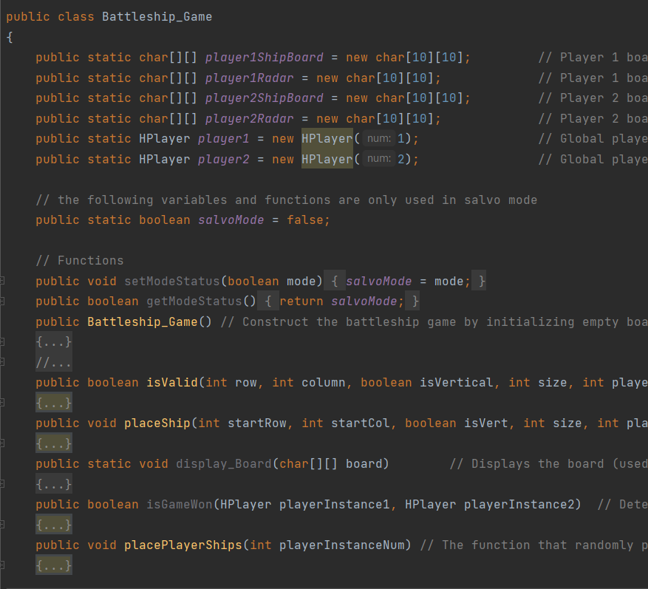
Battleship_Game
Notable functions:
Constructor: Instantiates 4 boards: two player “Ocean” boards (never visible) and two “Radar” boards.
isValid: Determines if a ship placement on the board is valid (i.e. if spaces are empty)
placeShip: Places the ship on the board when supplied with the ships size, orientation and starting location
placePlayerShips: The function that simultaneously places all 5 unique ships on the board at the same time
Main: Loads the start menu and constructs the player boards

Slide 6
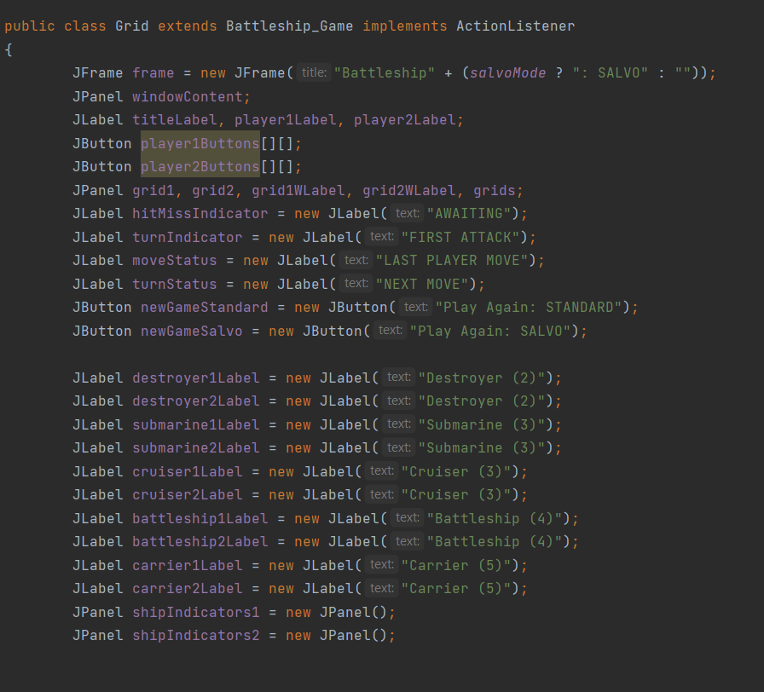
Grid
Develops all the labels and the board layouts in the game interface
Ship status indicators below the board indicate in RED when sunk
When a button is clicked, the UI updates the buttons color:
RED: The player hit the opponent’s ship
WHITE: The player missed
BLACK: The player has hit (and/or sunk) the opponent’s ship
One side of the board will turn gray and will be locked until a turn is complete (no self-damaging)
Indicators below ship status indicators will update to indicate which player’s turn it is.
These indicators will also display how many remaining moves a player has in “SALVO” Mode
Designated starting player designed ambiguous

Slide 7
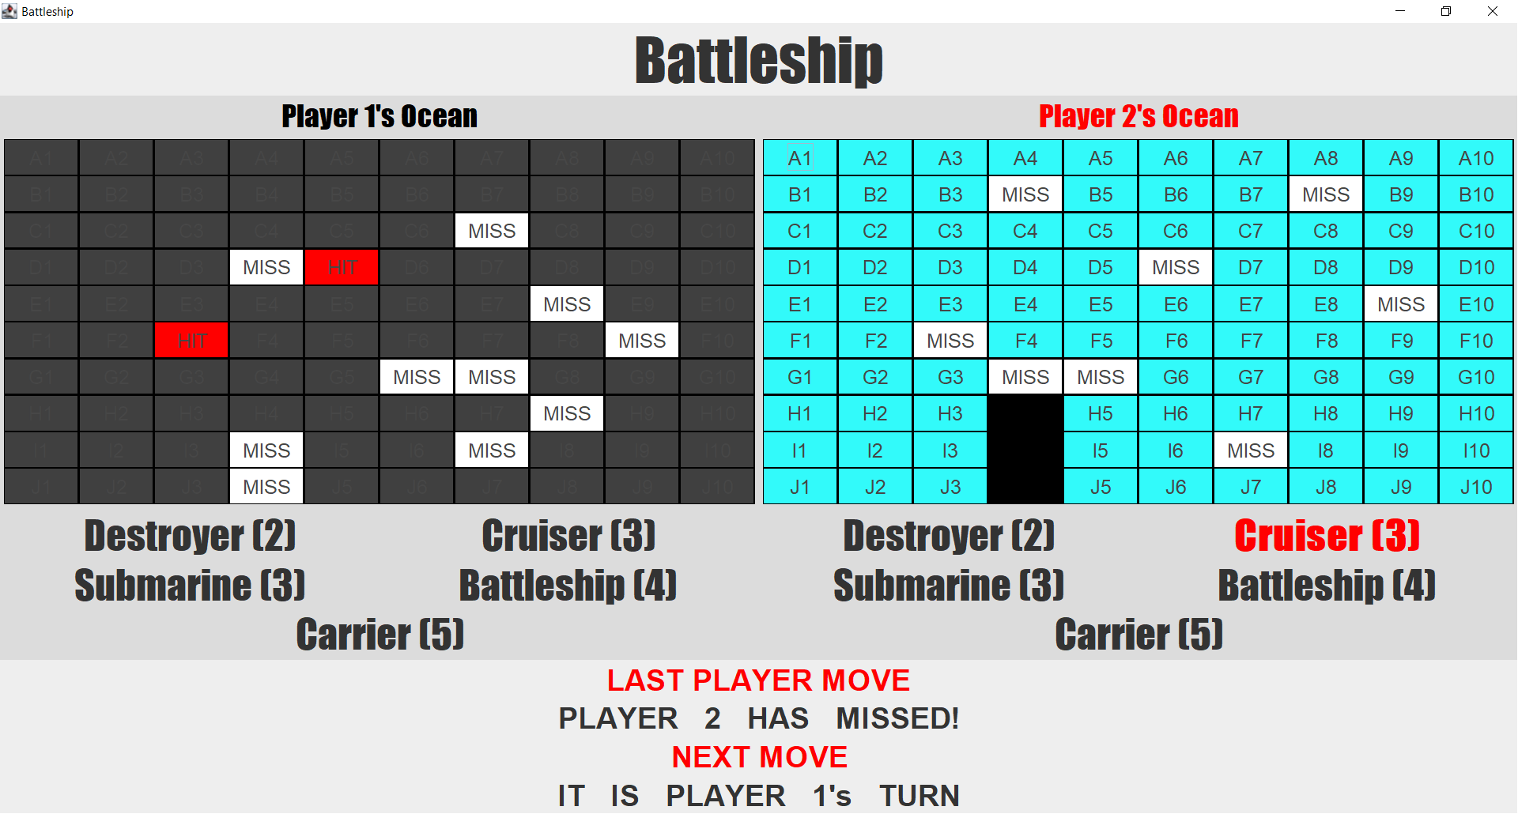

Slide 8
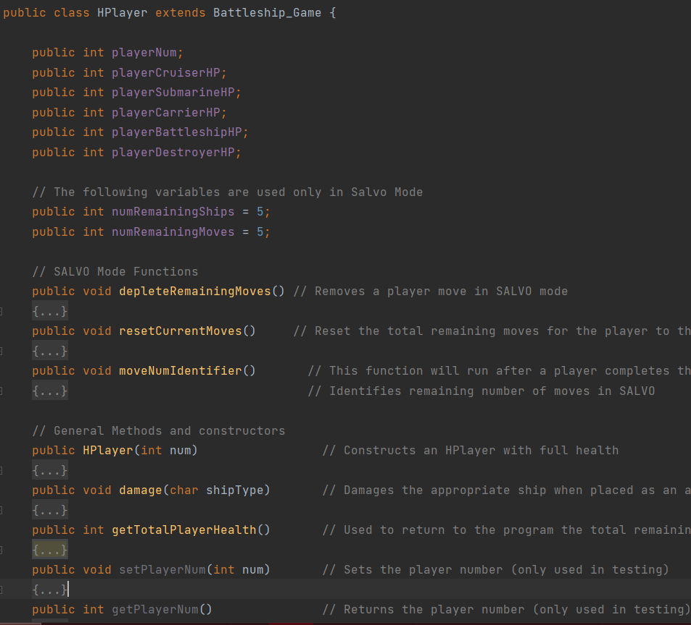
HPlayer
Utilizes integers with updating functions as opposed to separate ship classes for each individual ship
Holds the values for the players remaining moves (if in SALVO mode) and total remaining game health
Runs checks-and balances in Grid for game winning conditions and updating player turns in SALVO mode

Slide 9
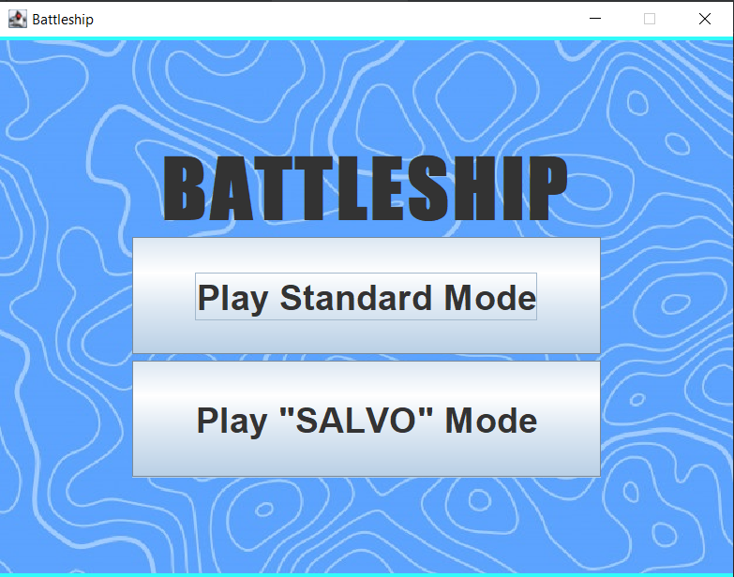
Extra Features In-Game
Unique Audio Signatures
Audio will play unique explosion sounds depending if a player registered a “HIT” or “MISS”
Explosions for HIT
Splashes for MISS
SALVO Game Mode
Designed by HASBRO
Players fire multiple times: one time for each ship they have remaining. Remaining turns unchanged regardless if registered “HIT” or “MISS”
Start Menu
User can select between “Standard” Battleship (no rule changes), or the “SALVO” Mode

